Slide 1


Intel® Intelligent Systems Center of Excellence (CoE), HPC Artificial Intelligence and Edge Computing School of Computing Science and Engineering Galgotias University
Data Science and Artificial Intelligence Research Group School of Computing Science and Engineering
“Hand Sign & Gesture Recognition System”
Team Member’s Details BT3192
S. No. | Participant Name | Mobile NO. | Mail ID
1 | Manish Kumar | 7827043684 | sahmanish10987@gmail.com
2 | Tarun Kumar | 8076831042 | Tarun.20scse1010846@galgotiasuniversity.edu.in
3 | Anirudh Kumar | 8125758436 | Anirudh.20scse1010801@galgotioasuniversity.edu.in
Faculty (College) Mentor’s Details
S. No. | Mentor Name | Mobile NO. | Mail ID
1 | Dr. Krishna K. Agrawal | 7398032912 | krishna.agrawal@galgotiasuniversity.edu.in

Slide 2

INTRODUCTION
Data Science and Artificial Intelligence Research Group School of Computing Science and Engineering
Hand gesture is one of the methods used in sign language for non-verbal communication. It is most commonly used by people who have hearing or speech problems to communicate among themselves or with normal people. Various sign language systems have been developed by many makers around the world but they are neither flexible nor cost-effective for the end users. Hence in this proposed “Hand sign and gesture recognition system software” which presents a system prototype that is able to automatically recognize sign language to help deaf and dumb people to communicate more effectively with each other or normal people. This system can also be used in platforms like “YouTube” videos where there is currently no feature for auto-text generation on the basic of gestures and sign languages. Gesture recognition is the developing fields of research. Being a significant part in nonverbal communication hand gestures are playing key role in our daily life. By considering in mind the similarities of human hand shape with four fingers and one thumb, the software aims to present a real time system for recognition of hand gesture and signs on basis of detection of some shape-based features like orientation, Centre of mass centroid, fingers status, thumb in positions of raised or folded fingers of hand, although these feature extraction part will be totally resolved by Convolutional Neural Network (CNN). In this we will capture every video frame and each frame will be used to locate hands to crop it from frame, which will work as input for out CNN.

Slide 3
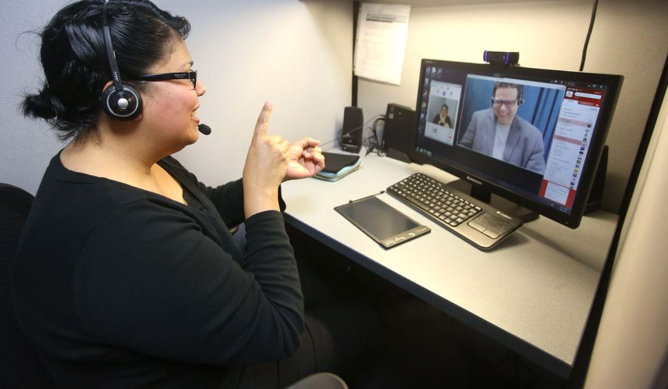
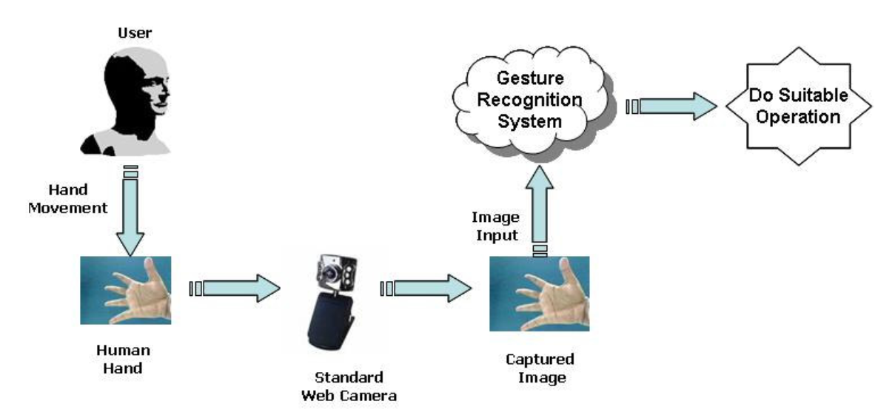
SCOPE
Data Science and Artificial Intelligence Research Group School of Computing Science and Engineering
“Hand sign and gesture recognition system software” which presents a system prototype that is able to automatically recognize sign language to help deaf and dumb people to communicate more effectively with each other or normal people.
This system can also be used in platforms like “YouTube”, “Netflix” etc., videos where there is currently no feature for auto-text generation on the basic of gestures and sign languages.
Even in video conference we can embed our system of better communication.
Can also be used in places like smart devices to control them via gestures rather than voice (for dumb people)
In other words this proposed “Hand sign and gesture recognition system” can be used for both public welfare and commercial use.

Slide 4

DRAWBACKS OF EXISTING SYSTEM/ STUDY
Data Science and Artificial Intelligence Research Group School of Computing Science and Engineering
The main drawbacks in the existing system are as follows.
Works only on static hand signs and gestures and fails for gestures which require continues movement.
No proposed research/ experiment shows any particular case which can handle little variations in variety (almost 3000+) of gestures with high accuracy.
NO study is done to reduce the timing of locating Region of Interest (in our case hand sign/ gesture region) in short time to increase efficiency.

Slide 5
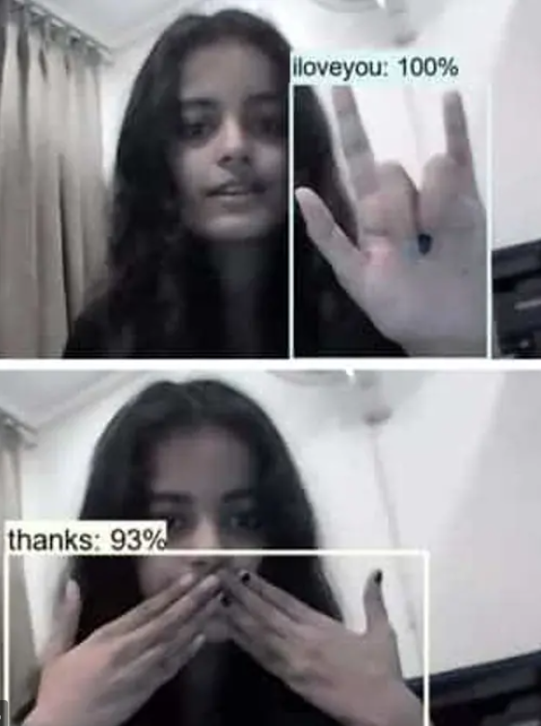
Advantages of Hand Sign & Gesture Recognition System
Data Science and Artificial Intelligence Research Group School of Computing Science and Engineering
In smart devices which usually performs basic operations via voice command, we can use this system to help dumb/mute people.
Increase interactions by recognizing sign language to help deaf and dumb people to communicate more effectively with each other or normal people.
Helps in entertainment: This system can also be used in platforms like “YouTube”, “Video-Conference call” etc. videos where there is currently no feature for auto-text generation on the basic of gestures and sign languages.

Slide 6



Flow Chart to Explain the proposed working of idea.
Data Science and Artificial Intelligence Research Group School of Computing Science and Engineering
Raw video footage will act as a input for our software input.
Raw video footage is now broken down to frames.
Then these frames will be then sent to Haar Cascade model to filter out the Region of Interest(ROI), in our case it is hands.
Then these ROI are now cropped out of frames and sent to CNN model which will classify these images.

Slide 7
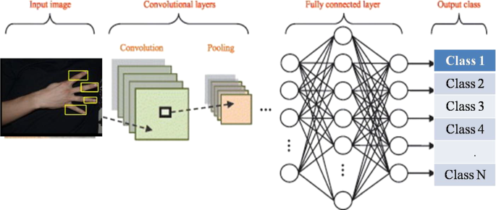
Flow Chart to Explain the proposed working of idea.
Data Science and Artificial Intelligence Research Group School of Computing Science and Engineering
The CNN model will now classify.
The performance of models will determine the accuracy of the software.

Slide 8
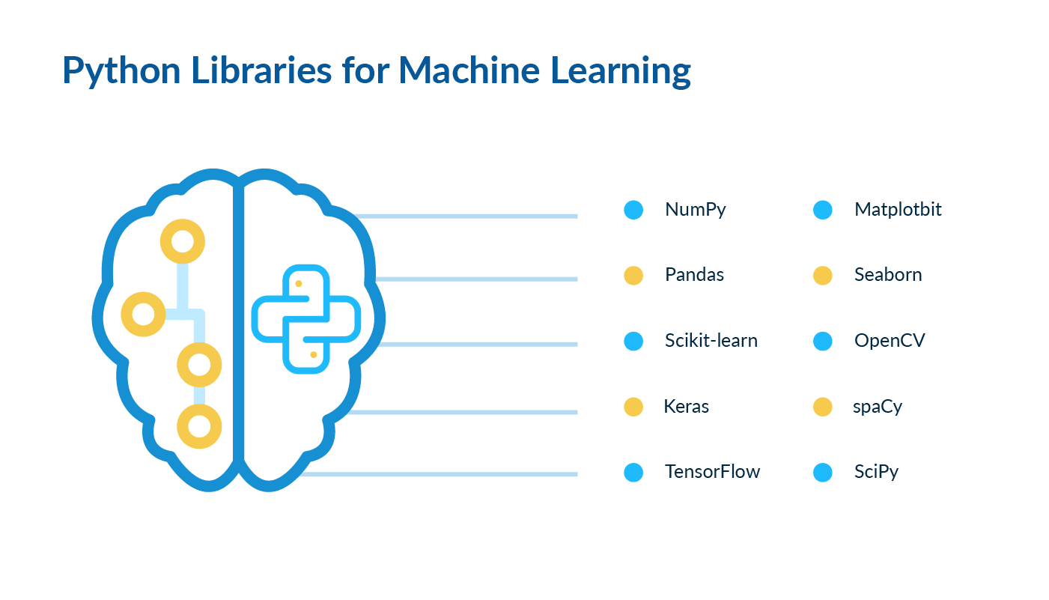
HARDWARE & SOFWARE REQUIREMENTS
Data Science and Artificial Intelligence Research Group School of Computing Science and Engineering
Hardware :
Computation Device ( RAM: 2Gb+, Storage: 32Gb+)
Camera
Python library’s required in the project :
Pandas
NumPy
Scikit learn
Pytouch
Tkinter
PIL
Keras
OpenCV
TensorFlow

Slide 9
Literature Survey
Data Science and Artificial Intelligence Research Group School of Computing Science and Engineering
Dynamic Hand Gesture Based Sign Word Recognition Using Convolutional Neural Network with Feature Fusion
Introduction: Gesture-based sign language recognition systems play an important role in human-computer interaction to develop communication between deaf communities and other people, and there are studies already that works in gesture recognition using Convolutional Neural Network (CNN) after some pre-processing of input data from input device. But in those studies, the diversity and complexities of the gesture of the hand greatly affects the reliability and recognition rates. To tackle this problem the authors (Md Abdur Rahim, Jungpil Shin, Md Rashedul Islam) introduce an effective method in the research paper, hand gesture recognition using CNN but using better data pre-processing including feature fusion CNN, RGB colour input to YCbCr, binarization, erosion and hole filling.
Methodology Used: In the research paper, the method proposed included we mainly focuses on data pre-processing as this method sures the accuracy for multiple gesture types as shown in research paper. We take the input image and transform it into YCbCr image from RGB then the image is transformed to different components of YCbCr (such as Y: luminance, Cb: Blue-Y, Cr: Red-Y) which is then transformed to grey scale image with threshold of black or white as 128 Luminous value (0 (Black) luminous < 128 else 1 (White)). With this the processing of image will become faster and feature extraction will become faster. Then we apply erosion to the binary image which removes the regions of boundaries of foreground pixels. Thus, the size of the foreground pixels is shrunk in size, and the holes in the area became larger. Finally, we fill those holes and accept the image of the hole that is used to extract the feature. The rest of CNN follows 2 set of convolution and pooling layers and rest is Artificial Neural Network (ANN).
Conclusion: It is clear that traditional ANN models developed in past are good and without much alterations but by just changing the method how we pre-process the images for our CNN model this changes the whole scenario. With just this slight alterations in data pre-processing our accuracy went up to 96.96% with faster processing (by reducing image size and dimension in data pre-processing and CNN layers). But there is a draw back in the methods proposed as it relies on erosion and not on “dilation” as otherwise when the same model is implemented on wider varieties of gestures it will definitely result in lower accuracy. And this method only works on the gestures which are only static which doesn’t require any continuous movement therefore future scope would be hand tracking and gesture recognition but it will require different dataset to work with.

Slide 10
Literature Survey
Data Science and Artificial Intelligence Research Group School of Computing Science and Engineering
Methodology used: In this research authors (Md Rashedul Islam, Rasel Ahmed Bhuiyan, Ummey Kulsum Mitu and Jungpil Shin) have thought of instead of focusing in solemnly in data pre-processing as other latest research papers at that time a new way to categorise them using Multi-class Support Vector Machine (MCSVM) which results in higher efficiency and productivity with the increase in number of specimen or categories (types of gestures). In MCSVM the general principle of SVM is utilised after breaking down the multi-class problem into sub-problem all which are binary classification problems. This method increases the accuracy as showed in research paper but this is not the only factor for great accuracy, but data pre-processing is also used. They filtered the inputted images by removing background images only showing the Region of Interest (ROI) i.e., hands. But the speed of prediction is slowed considerably as they used very inefficient method to remove background images by taking two images one with ROI and one without, which made accuracy less accurate, costing the model to achieve average accuracy of 95% approx. And after that background removal filtering noise reduction and convert them to grey scale.
Hand Gesture Feature Extraction Using Deep Convolutional Neural Network for Recognizing American Sign Language
Introduction: For Human-Computer Interaction (HCI) the use of Hand Gesture Recognition (HGR) is most significant way to use, and a major part also. Extracting feature and detecting hand gesture from inputted color videos is more challenging because of the huge variations in hand gestures. But to tackle this solution a Deep Neural Network (DCNN) is used for extracting efficient hand features to recognize sign language. Then at the end layer of DCNN a Multi-class Support Vector Machine (MCSVM) is used for identifying the hand sign, where a CNN model extract features that are used to train the model.
Conclusion: The method used in last layer of ANN made the prediction much efficient but with the increase in variation in hand gestures to wider prospective (not only to alphabets, numbers and simple hand signs) the accuracy can decrease tremendously and this method is basic for Human Computer Interaction which defeats the purpose of this research but at the same time it also opens up other opens for future technology which requires less variety of gestures for easier Human Computer Interaction for smart systems it can be very fruitful. In the method discussed the application of its use is not diverse as it’s data pre-processing requires much time, but in other sectors of Smart Technology with less variety of gestures and easy Human Computer Interaction it will be of great use.

Slide 11
Literature Survey
Data Science and Artificial Intelligence Research Group School of Computing Science and Engineering
A Static Hand Gesture Based Sign Language Recognition System using Convolutional Neural Networks
Introduction: In recent research papers about gesture recognition system using CNN and Deep Learning there were only few papers which focuses on Region of Interest (ROI) segmentation from image which made the accuracy lower and especially for hand signs and gestures which has almost more than 3000 different signs and to classify them accurately on the basis of different features which have little variations compared to others, so the image segmentation is very crucial point which was observed by authors (Diksha Hatibaruah, Anjan Kumar Talukdar and Kandarpa Kumar Sarma) and utilised them in their study for making much better accuracy, giving them average of 99.85% accuracy in testing phase. They have applied Histogram Back-Projection technique for segmentation of images for dataset generation for better training material. These datasets are then formed into classes which are fed to a CNN.
Methodology used: In this research, authors didn’t use any pre-available dataset for training, testing and validation of the CNN model. But they created their more accurate dataset using Histogram Back-Projection technique for segmentation of images. This technique revolves around the high contrast difference between the hand in ROI compared to background and used a histogram placed in ROI to get a threshold value for the hand gesture and categorise them in their respective categories (A-Z alphabets and 0-9 Numbers). And after dataset generation we split them for testing (15%) and training (15%). CNN model which has 2 section, 1st section has 3 convolution and pooling parts and 2nd section has 2 Sequential layers with 1 dense layers each and from here on the standard ANN architecture continues. This CNN model made with custom dataset provided by far the best accuracy for Hand sign and gesture recognition.
Conclusion: This method of image segmentation using histogram ROI technique is most suitable for best results but it has one drawback and very crucial one, as it cannot be used in dynamic situations like live videos or videos but in the positive side, we can now classify different gestures based on threshold used in this research papers to maximise variations in different features of hand gestures. But for the drawback we can use computer vision to locate hand then place the histogram there to tackle dynamic situations but it will slow the process but will work in most applications, and with the help of High-Performance Computation we can resolve this issue.

Slide 12
Bibliography
Data Science and Artificial Intelligence Research Group School of Computing Science and Engineering
https://doi.org/10.1109/ICKII46306.2019.9042600
https://doi.org/10.1109/ICFSP.2018.8552044
https://doi.org/10.1109/INDICON49873.2020.9342405
https://en.wikipedia.org/wiki/Convolutional_neural_network
https://github.com/Sah-Manish/Hand-Sign-and-gesture-recognition-system-using-CNN-Galgotias-Project-Intel-FICE-

Slide 13
THANK YOU
Data Science and Artificial Intelligence Research Group School of Computing Science and Engineering

